Slide 1




Automated Integration of Metrological metadata into Oceanographic Datasets
Enoc Martínez, Albert Garcia-Benadí, Florence Salvetat, Matias Carandell, Joaquín del Río

Slide 2
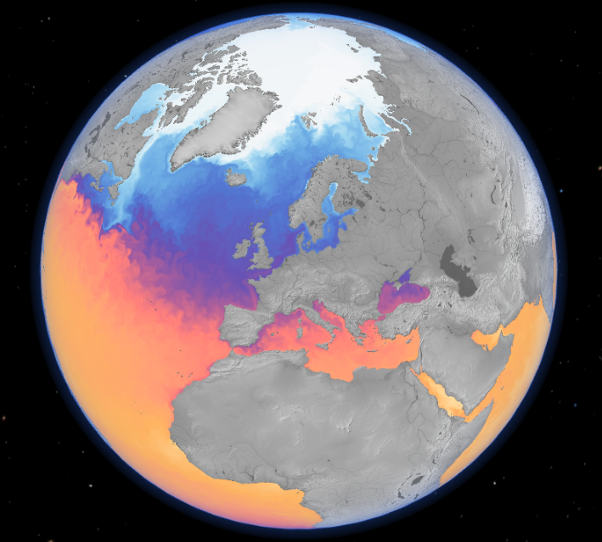
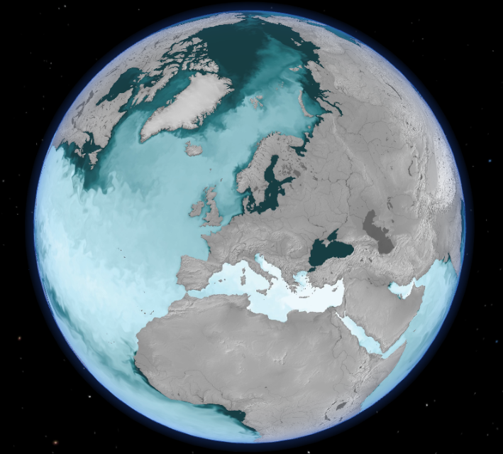
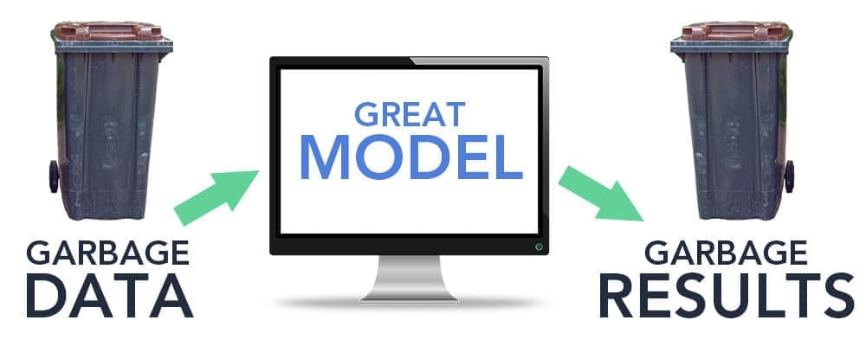
Motivation & Background
Accurate models and forecasts rely on sensor data
Data quality is of utmost importance
Bad quality data -> GIGO effect
Metrology required to ensure data quality:
  Calibration corrections
  Uncertainties
Automated Integration of Metrological metadata into Oceanographic Datasets
Enoc Martínez, Albert Garcia-Benadí, Florence Salvetat, Matias Carandell, Joaquín del Río

Slide 3
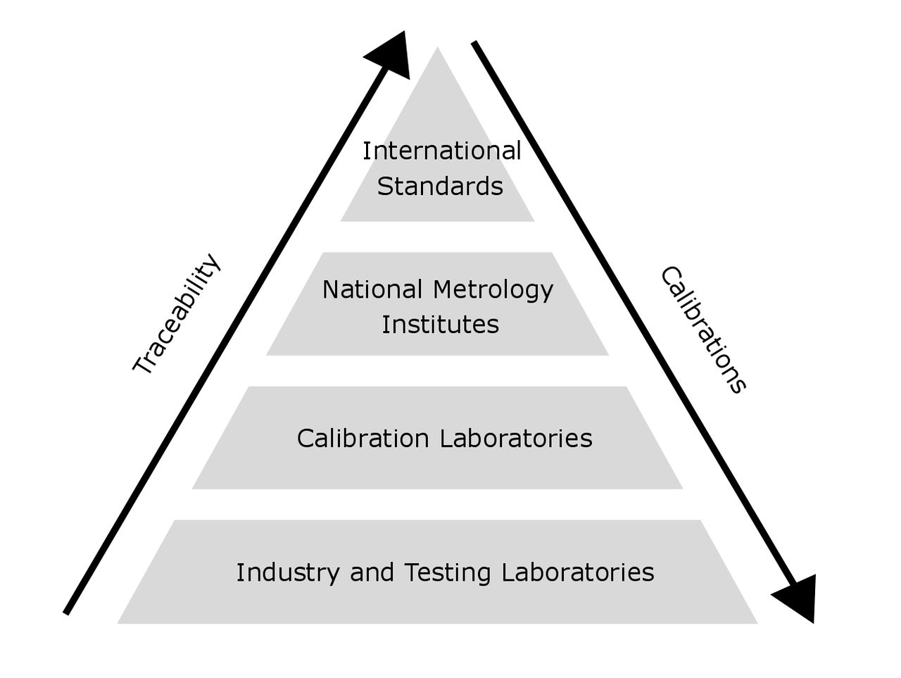
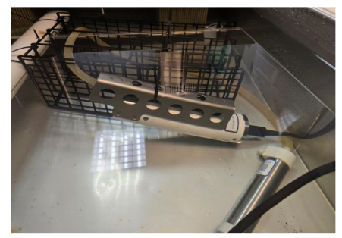
Challenges in Current Practice
Metrology is the scientific study of measurement
Defines the units of measurement
Traceability: linking measurements made in
practice to the reference standards
Calibration: comparison of the values delivered by a device under test with those of a calibration standard of known accuracy
  Corrections: post-measurements adjustments
  Uncertainty: dispersion of values
Automated Integration of Metrological metadata into Oceanographic Datasets
Enoc Martínez, Albert Garcia-Benadí, Florence Salvetat, Matias Carandell, Joaquín del Río

Slide 4
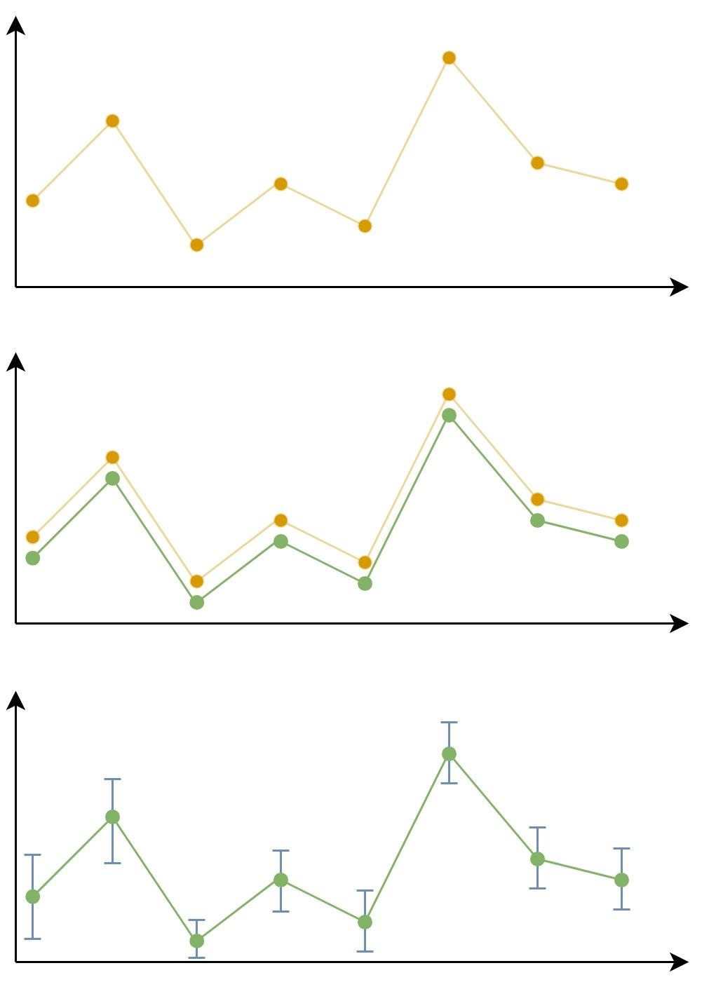
Metrology in Oceanography
Calibration Certificates: Report on the sensor performance
Two main values of interest:
  Corrections to be applied to the data
  Uncertainty associated to every measure
raw data
corrected data
corrected data +
uncertainty
Automated Integration of Metrological metadata into Oceanographic Datasets
Enoc Martínez, Albert Garcia-Benadí, Florence Salvetat, Matias Carandell, Joaquín del Río

Slide 5
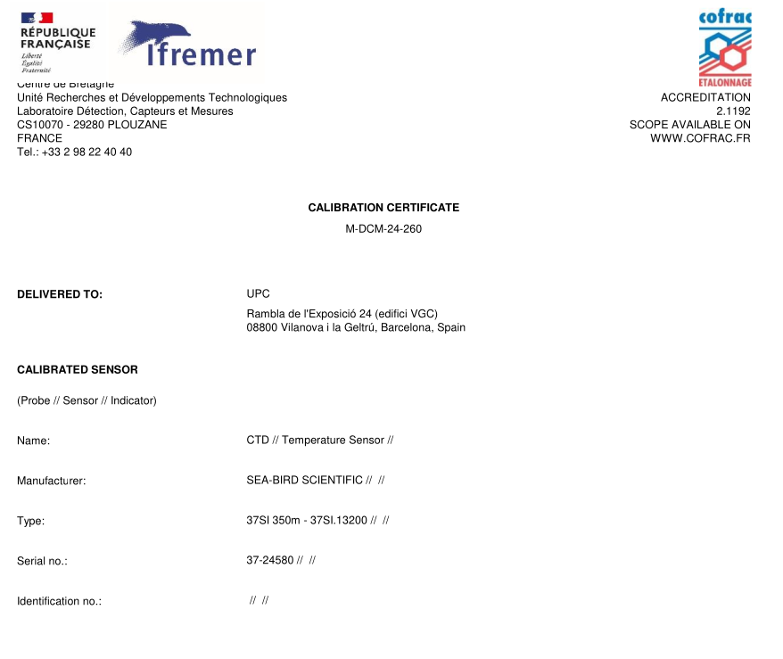
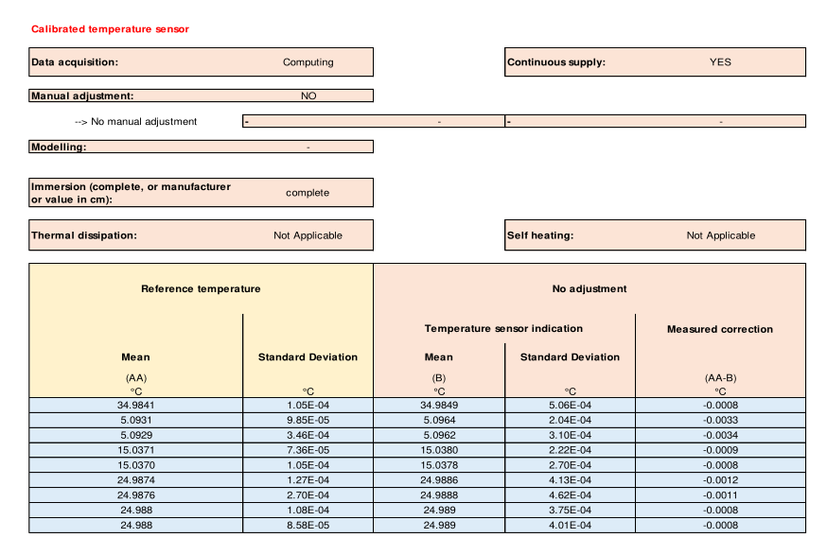
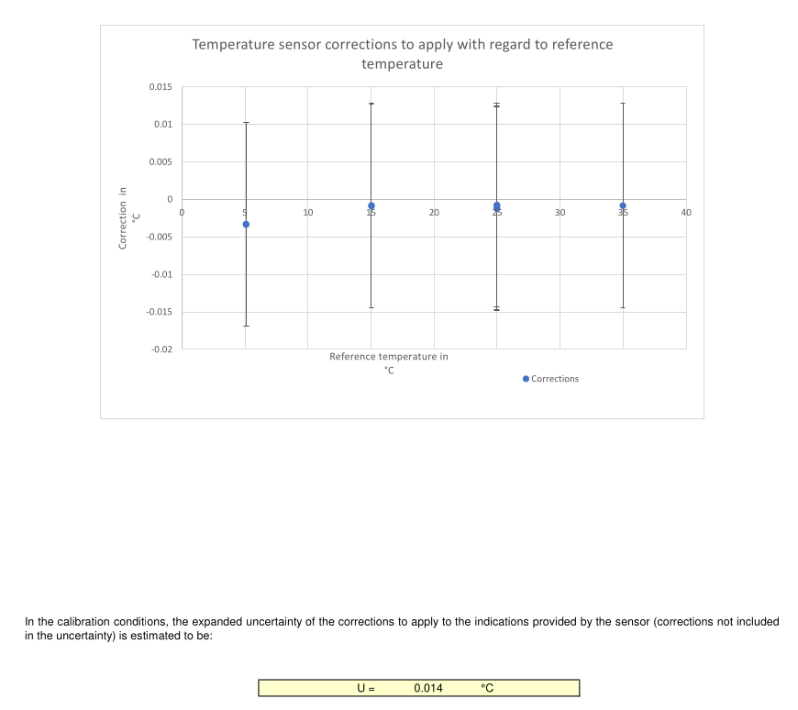
Calibration Certificates
Automated Integration of Metrological metadata into Oceanographic Datasets
Enoc Martínez, Albert Garcia-Benadí, Florence Salvetat, Matias Carandell, Joaquín del Río

Slide 6
Metrology in Oceanography
Calibration certificates in human-readable formats (PDF)
Data correction manually performed
Metrology expertise required for data processing
Modern systems may host tens / hundreds of sensors
Not scalable!
Automated Integration of Metrological metadata into Oceanographic Datasets
Enoc Martínez, Albert Garcia-Benadí, Florence Salvetat, Matias Carandell, Joaquín del Río

Slide 7
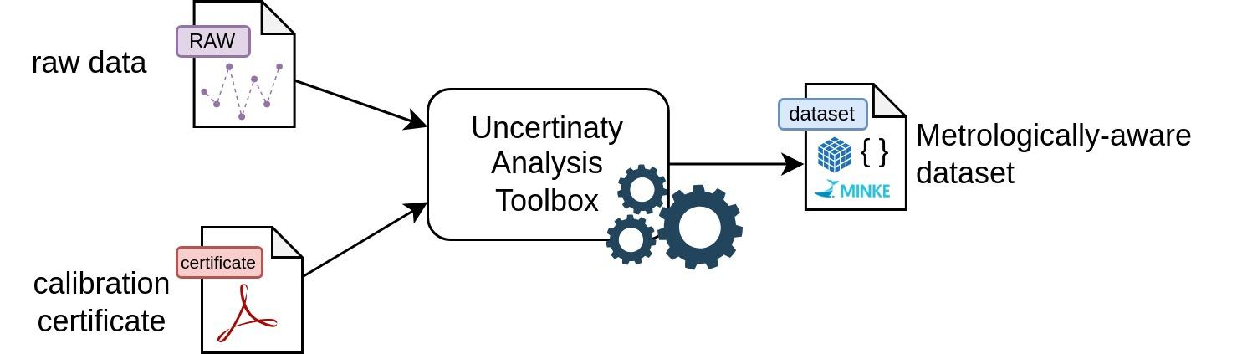
Automated Uncertainty Analysis
Automates calibration data integration
Common data formats (NetCDF nd CSV)
Interoperable calibration metadata
Embeds corrected values and uncertainties
Challenges:
Calibration certificates in PDF format
(human readable)
Need for machine-actionable
alternative
Automated Integration of Metrological metadata into Oceanographic Datasets
Enoc Martínez, Albert Garcia-Benadí, Florence Salvetat, Matias Carandell, Joaquín del Río

Slide 8
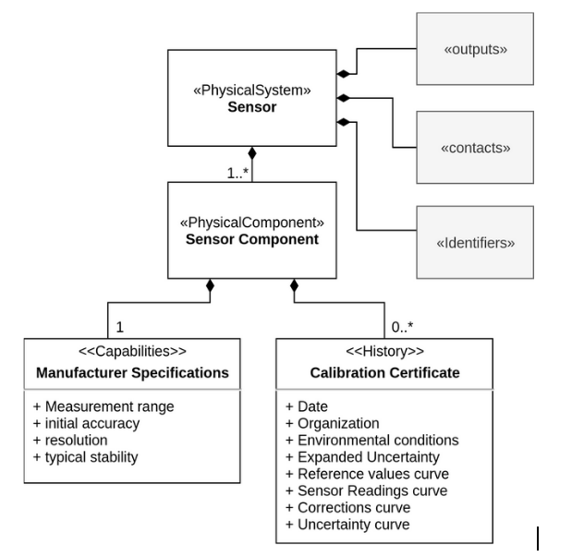
SensorML standard
SensorML: machine-actionable metadata
Focus on metadata interoperability
  Interoperability: Machine-to-machine information exchange and utilization
SensorML for Metrology:
  Template to encode calibration certificates into SensorML metadata files
  Can be parsed and interpreted by machines
  Automatization!
Automated Integration of Metrological metadata into Oceanographic Datasets
Enoc Martínez, Albert Garcia-Benadí, Florence Salvetat, Matias Carandell, Joaquín del Río

Slide 9
SensorML for Metrology
{
...
"components": [
{
...
"capabilities": [
{
"id": "specifications",
"description": "Manufacturer Specifications",
"capabilities": [
{
"type": "Quantity",
"label": "resolution",
"definition": "...",
"uom": {
"label": "°C",
"href": "http://.../P06/current/UPAA"
},
"value": 0.0001
},
"encoding": { "type": "JSONEncoding" },
"values": [
[0.000, 0.000, 0.000, 0.010],
[5.132, 5.132, 0.000, 0.030],
[9.976, 9.975, 0.001, 0.010],
[12.050, 12.048, 0.002, 0.010],
[14.978, 14.979, -0.001, 0.010],
[18.032, 18.030, 0.002, 0.010],
[20.028, 20.026, 0.002, 0.010],
[21.975, 21.973, 0.002, 0.010],
[24.974, 24.972, 0.002, 0.010],
[28.015, 28.012, 0.002, 0.010],
[30.028, 30.026, 0.002, 0.010]
]
}
]
Automated Integration of Metrological metadata into Oceanographic Datasets
Enoc Martínez, Albert Garcia-Benadí, Florence Salvetat, Matias Carandell, Joaquín del Río

Slide 10
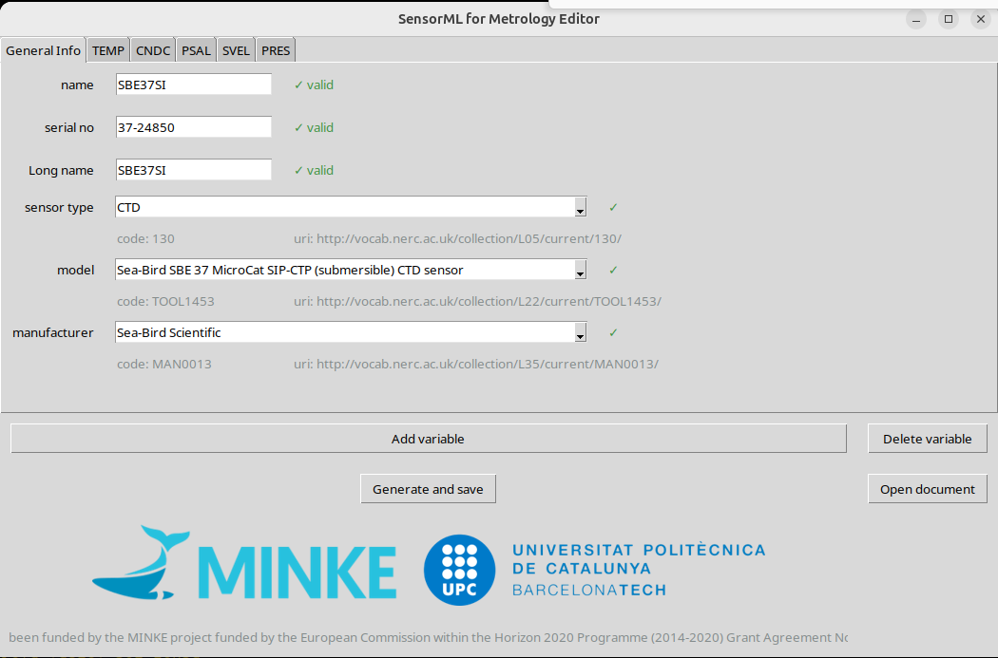
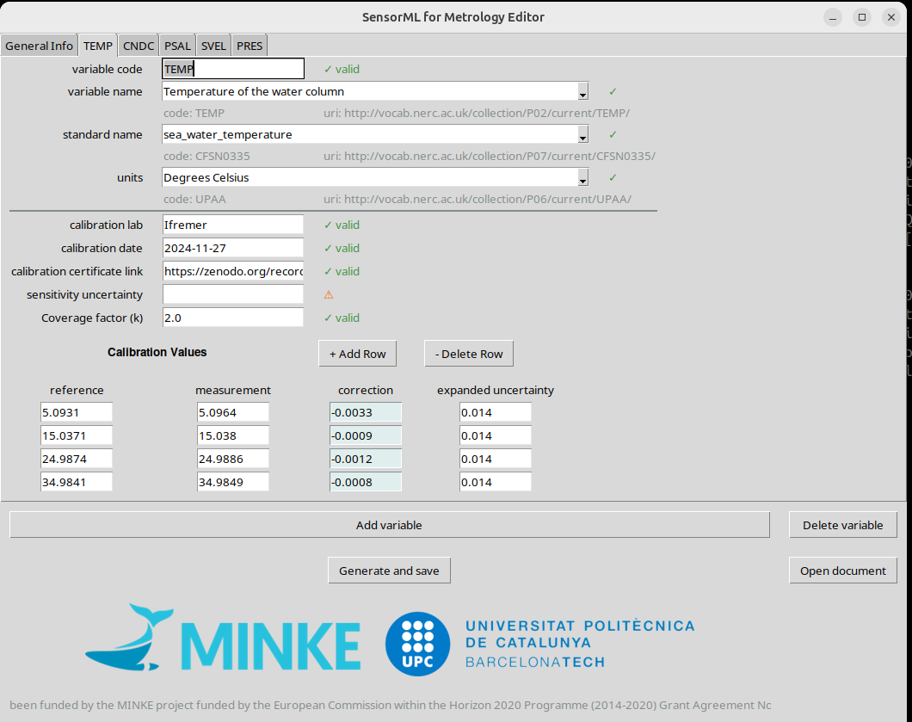
SensorML for Metrology Editor
SensorML is machine-actionable…
…but difficult to write manually
An user-friendly editor is needed!
Automated Integration of Metrological metadata into Oceanographic Datasets
Enoc Martínez, Albert Garcia-Benadí, Florence Salvetat, Matias Carandell, Joaquín del Río

Slide 11
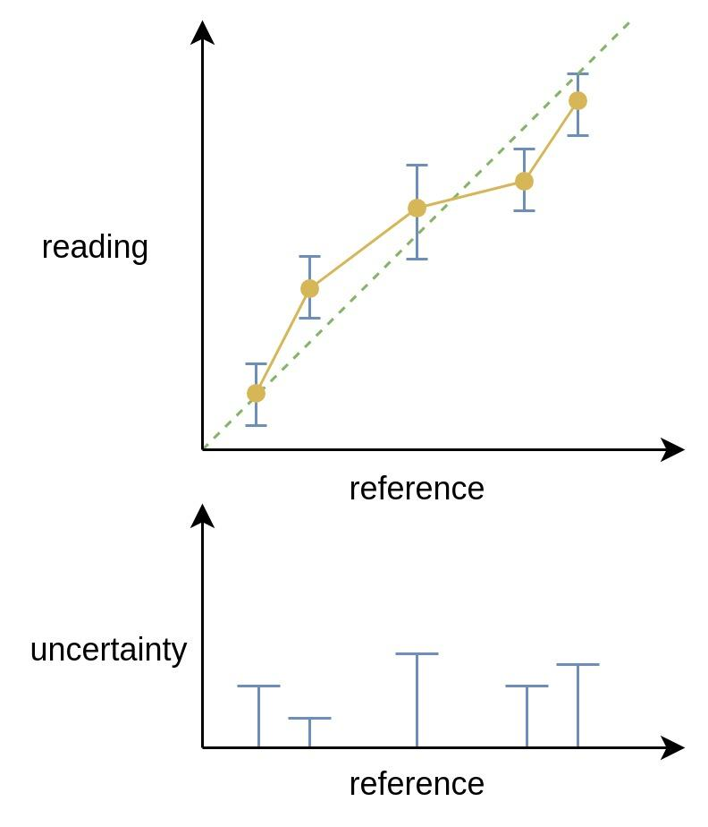
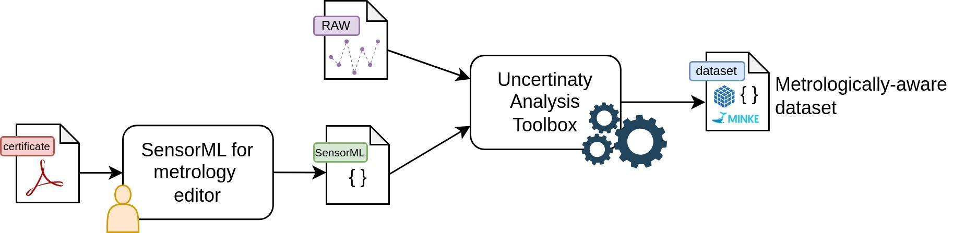
Automated Uncertainty Analysis
✓ Machine-actionable calibration certificate
Tool for automated uncertainty analysis
  Data correction
  Uncertainty estimation
Assumptions:
  Linear interpolation between measurements
  Worst-case scenario uncertainty
Automated Integration of Metrological metadata into Oceanographic Datasets
Enoc Martínez, Albert Garcia-Benadí, Florence Salvetat, Matias Carandell, Joaquín del Río

Slide 12
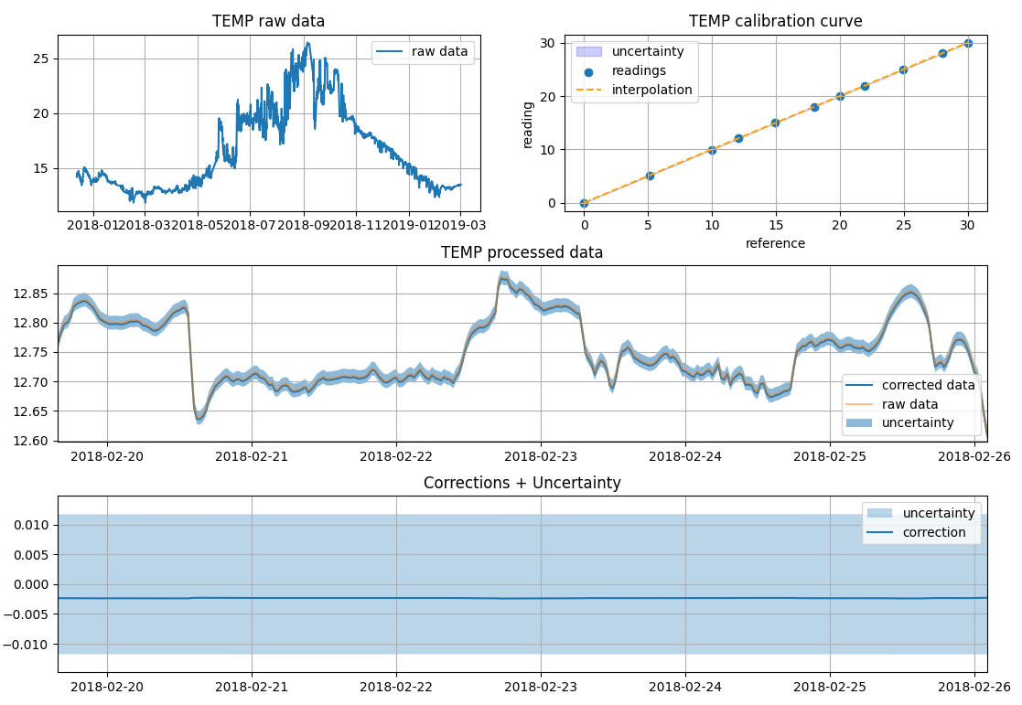
Automated Uncertainty Analysis
Automated Integration of Metrological metadata into Oceanographic Datasets
Enoc Martínez, Albert Garcia-Benadí, Florence Salvetat, Matias Carandell, Joaquín del Río

Slide 13
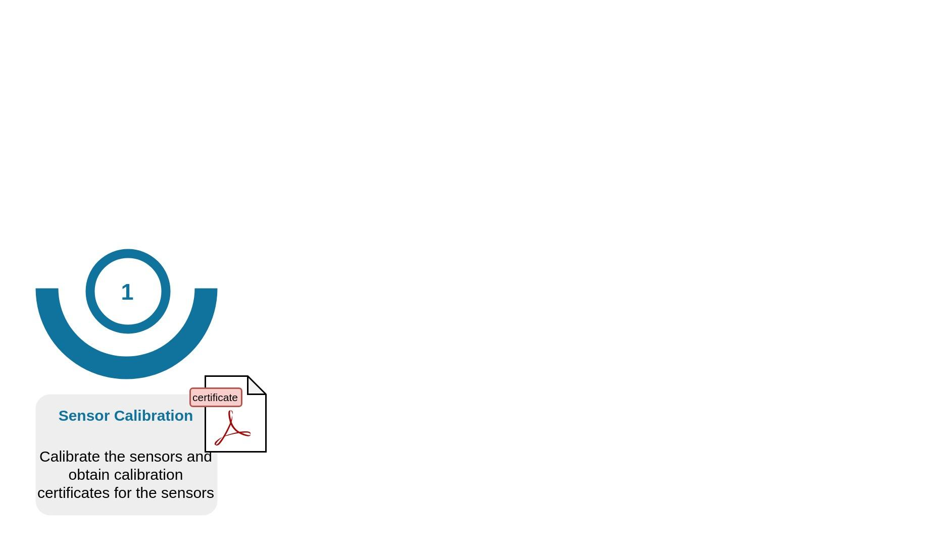
Metrological Analysis Workflow
Automated Integration of Metrological metadata into Oceanographic Datasets
Enoc Martínez, Albert Garcia-Benadí, Florence Salvetat, Matias Carandell, Joaquín del Río

Slide 14
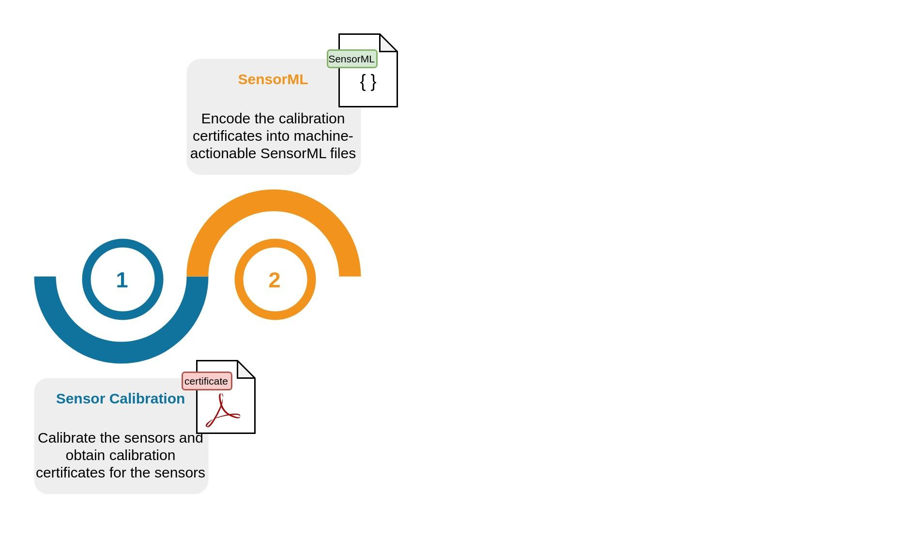
Metrological Analysis Workflow
Automated Integration of Metrological metadata into Oceanographic Datasets
Enoc Martínez, Albert Garcia-Benadí, Florence Salvetat, Matias Carandell, Joaquín del Río

Slide 15
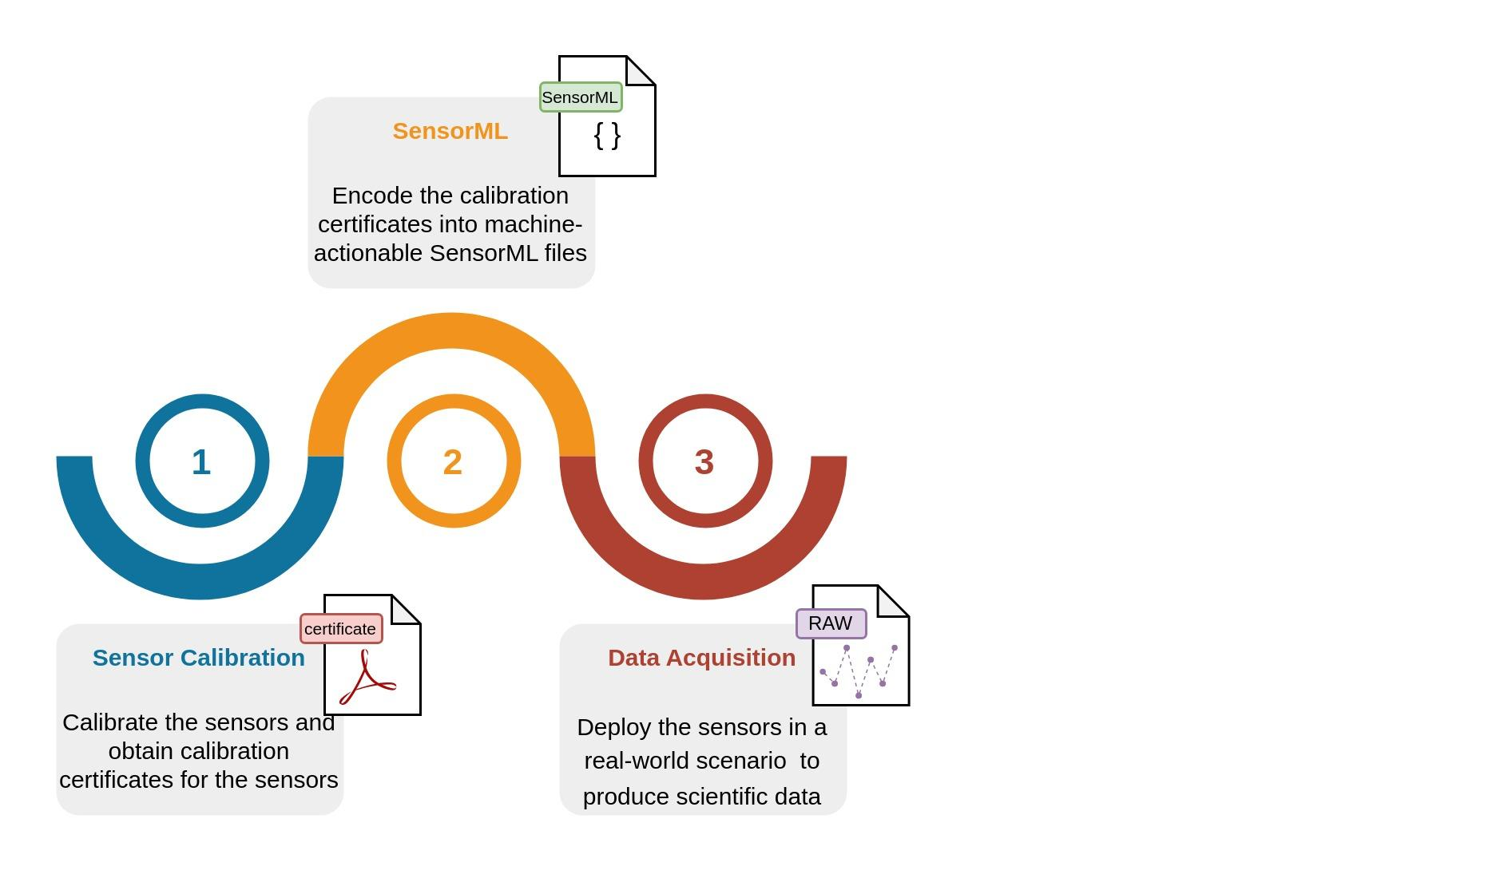
Metrological Analysis Workflow
Automated Integration of Metrological metadata into Oceanographic Datasets
Enoc Martínez, Albert Garcia-Benadí, Florence Salvetat, Matias Carandell, Joaquín del Río

Slide 16
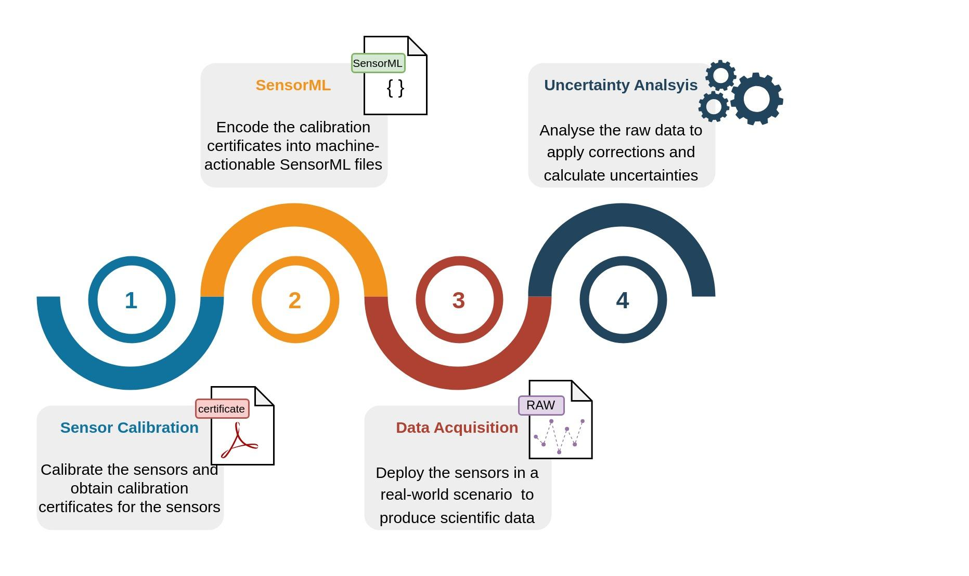
Metrological Analysis Workflow
Automated Integration of Metrological metadata into Oceanographic Datasets
Enoc Martínez, Albert Garcia-Benadí, Florence Salvetat, Matias Carandell, Joaquín del Río

Slide 17
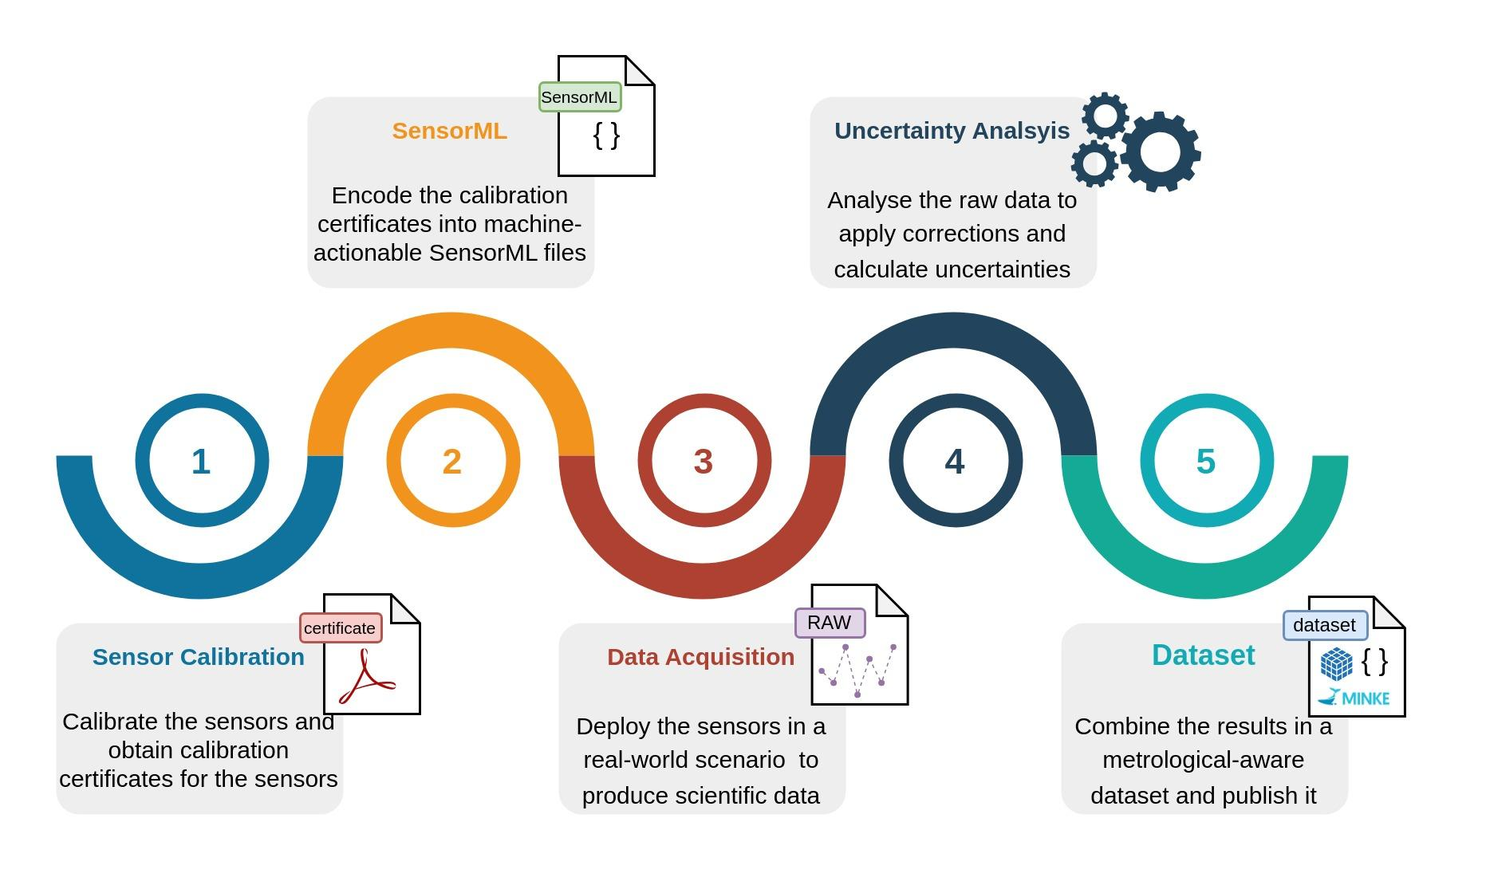
Metrological Analysis Workflow
Automated Integration of Metrological metadata into Oceanographic Datasets
Enoc Martínez, Albert Garcia-Benadí, Florence Salvetat, Matias Carandell, Joaquín del Río

Slide 18
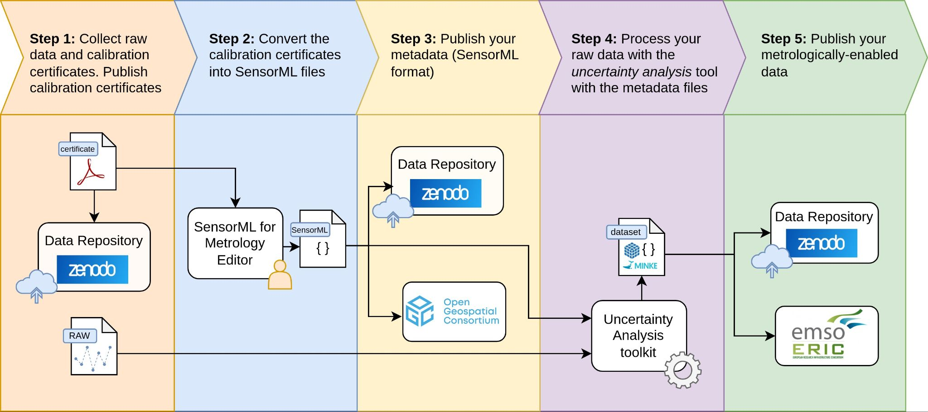
Dataset Publishing Workflow
Automated Integration of Metrological metadata into Oceanographic Datasets
Enoc Martínez, Albert Garcia-Benadí, Florence Salvetat, Matias Carandell, Joaquín del Río

Slide 19
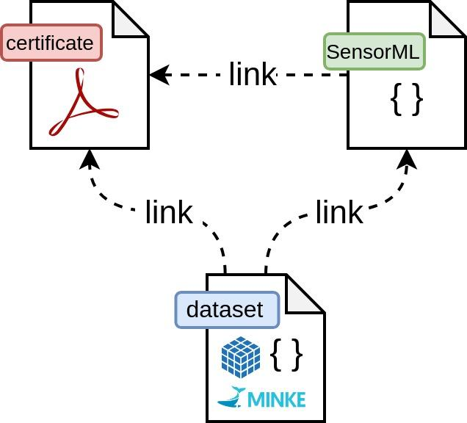
Conclusions
✓ Machine-actionable calibration certificates
✓ User-friendly interface to generate them
✓ Automated correction/uncertainty estimation
✓ Scalable solution
✓ Enriched datasets with metrology information
✓ Traceability of the calibration
Automated Integration of Metrological metadata into Oceanographic Datasets
Enoc Martínez, Albert Garcia-Benadí, Florence Salvetat, Matias Carandell, Joaquín del Río

Slide 20
Thank you for your attention!

